Slide 1

Gender Pay Gap (UK)
Yusuf Isa AlDoy

Slide 2

Agenda
The Dataset
Average Pay Gap
Pay Gap In Industries
Pay Gap In Different Regions
The Largest Gaps
Restrictions
Q&A

Slide 3
The Dataset
There are 10,464 records in the dataset to be looked over.
With 27 features to be covered
The dataset is based on companies located in the United Kingdom (UK)
The sample is based on the year of 2021 to 2022

Slide 4
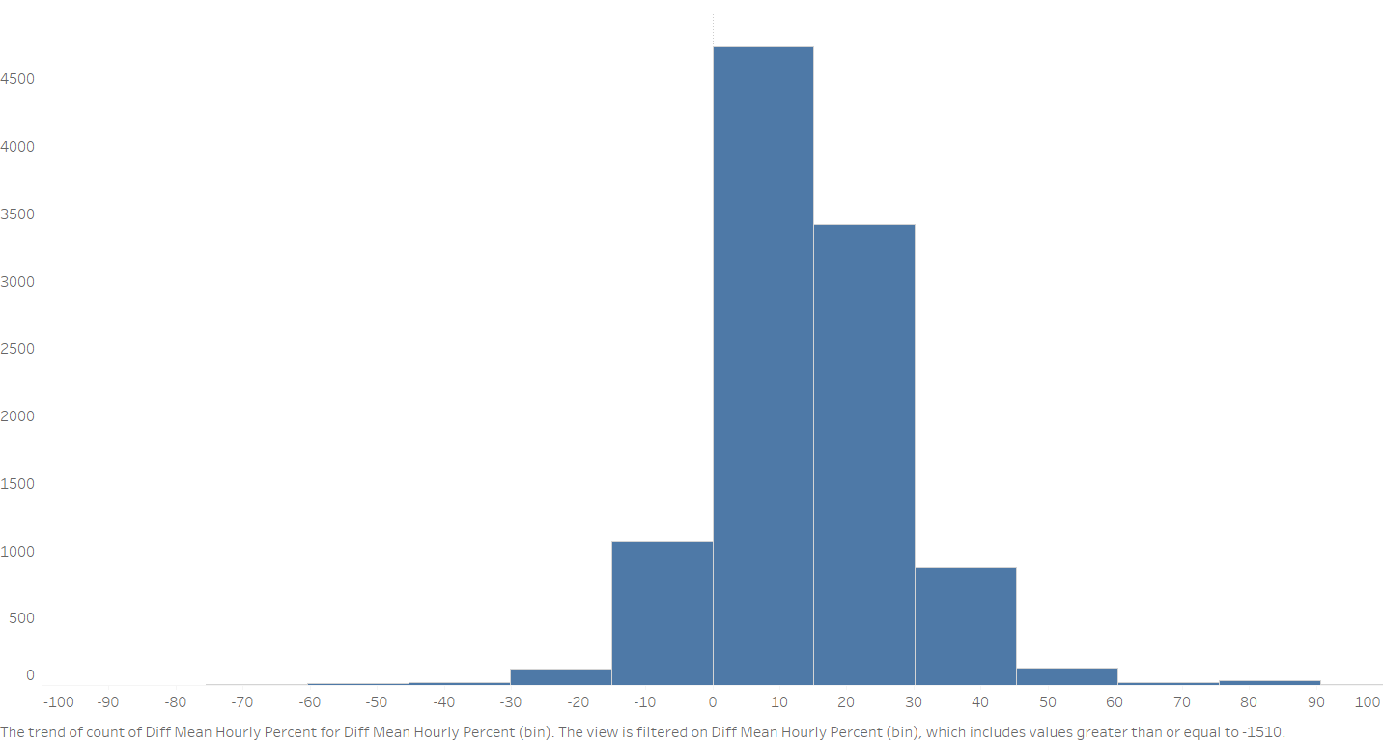
Average Pay Gap
The average value of the average pay gap between all companies is 13.63. We used the Average Mean Hourly Percent as our main calculator for averaging.

Slide 5
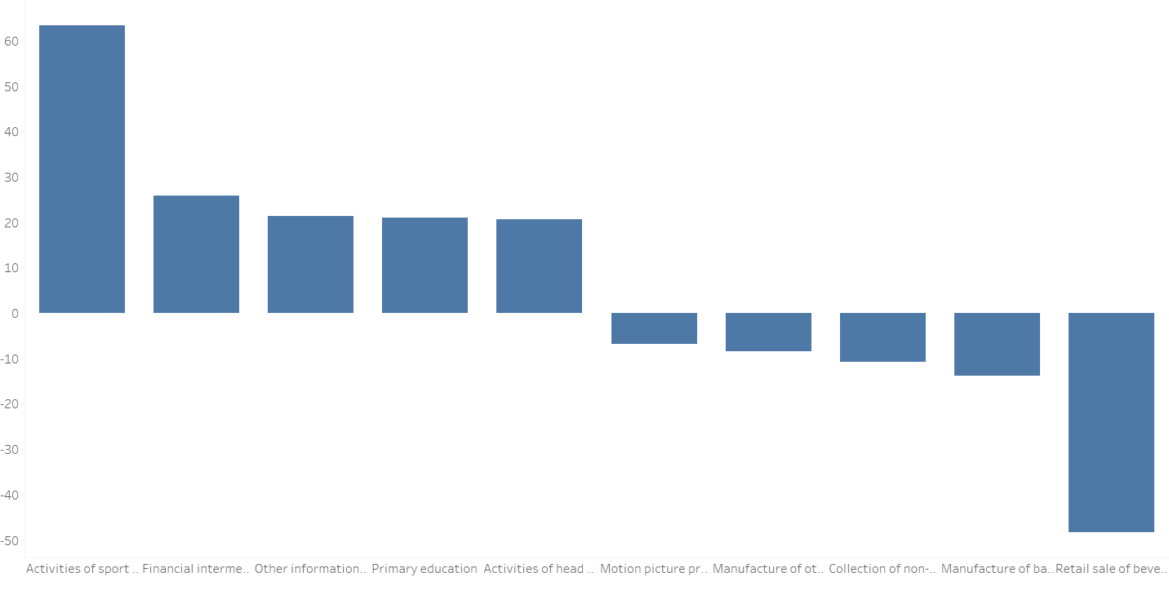
Pay Gap in Industries
The image above shows the top five with the highest gap in the industry for the males and females

Slide 6
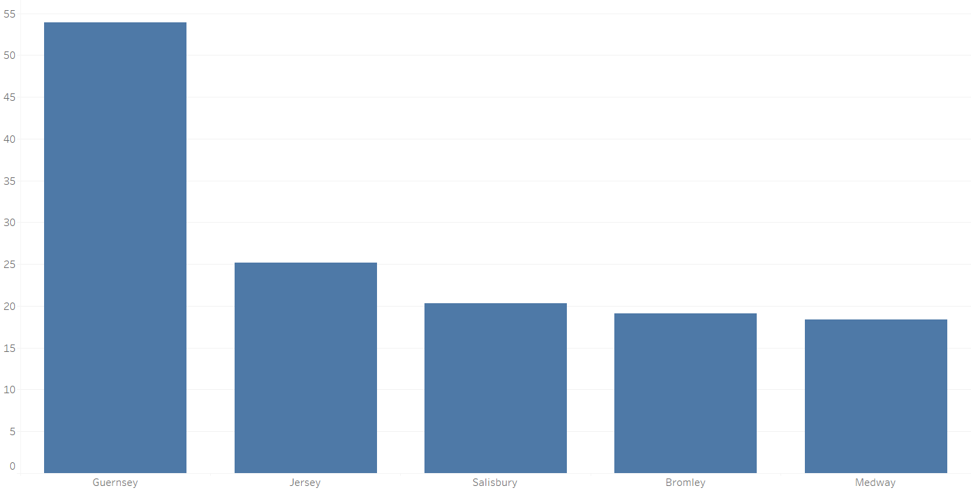
Pay Gap in Regions
Guernsey has the highest male pay gap with more than 50%

Slide 7
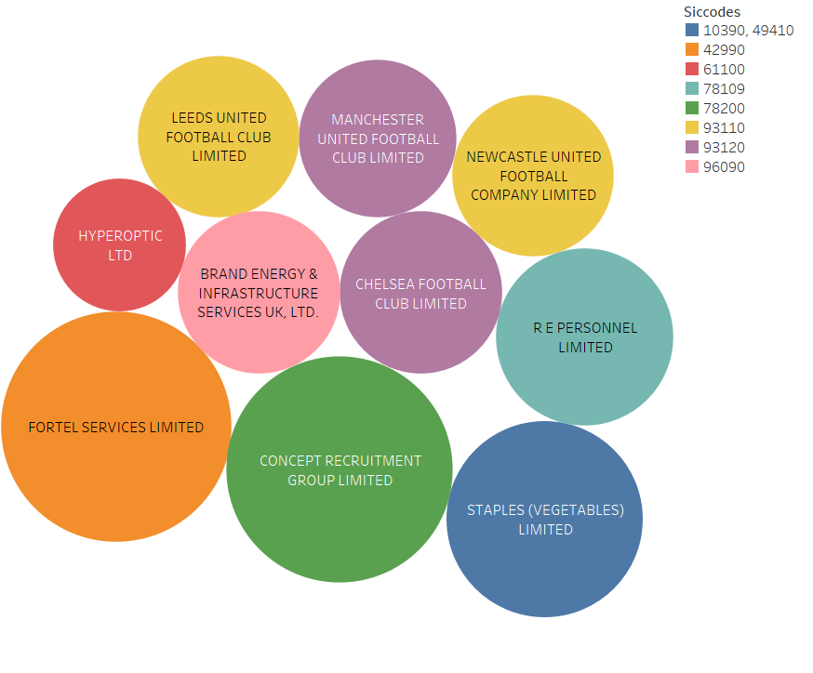







The Largest Gaps
These are the 10 biggest gaps for male and female gaps

Slide 8
Data Restrictions
The data had “0” as a value, empty, and null which caused a lot of issues trying to figure out when the 0 was actually what it represented.
Time restriction slowed down the process to get a more accurate percentages and calculations
Inaccurate and missing data

Slide 9

Q&A

